Slide 1
Setting Up a GitHub Account

Slide 2
Setting Up a GitHub Account
Navigate to https://github.com/. Enter your user details, as shown in the following screenshot, and press the Sign up for GitHub button:

Slide 3
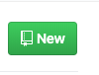
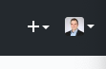
Creating your first repo on GitHub
Step 1: On GitHub, you can start creating your repo by either clicking on the New button:
Or the + symbol next to your avatar at the top right corner of the page

Slide 4
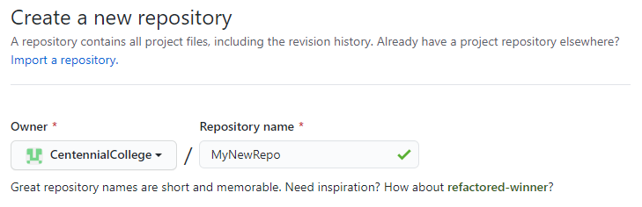
Creating your first repo on GitHub (continued)
Step 2: Select a repository name next to your account or team name. The name of the repo must be unique for your account:

Slide 5
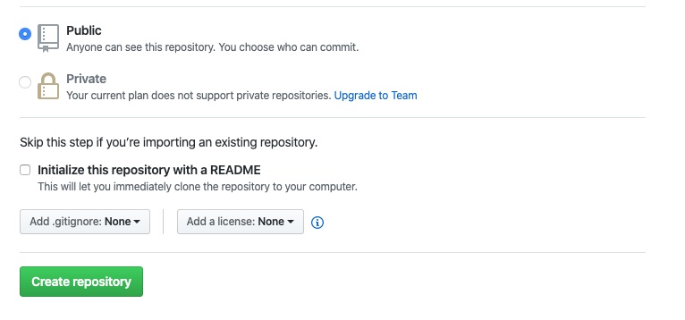
Creating your first repo on GitHub (continued)
Step 3: You can leave the repo as public for now. Also, you can leave initialize this repository with a README unchecked.
Step 4: Click the Create repository button.

Slide 6
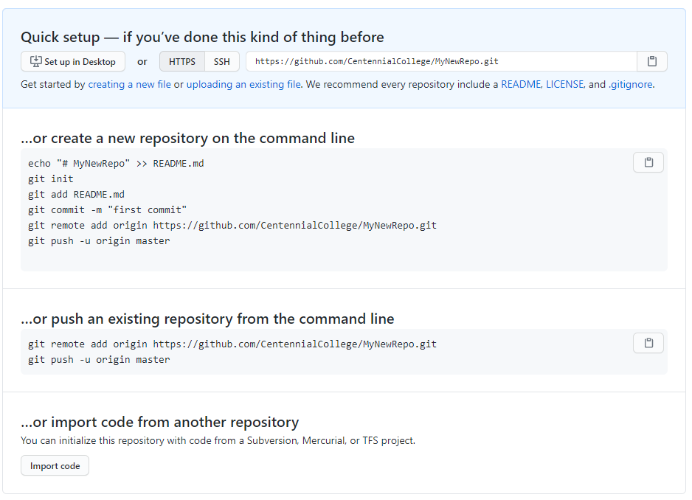
Connecting your local repo to your GitHub repo
GitHub will create the new repo and display a page with the following information:

Slide 7
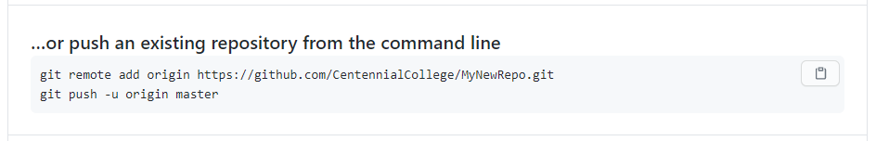
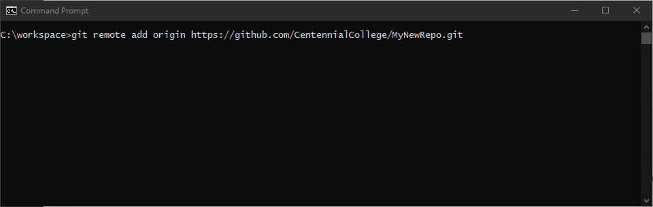
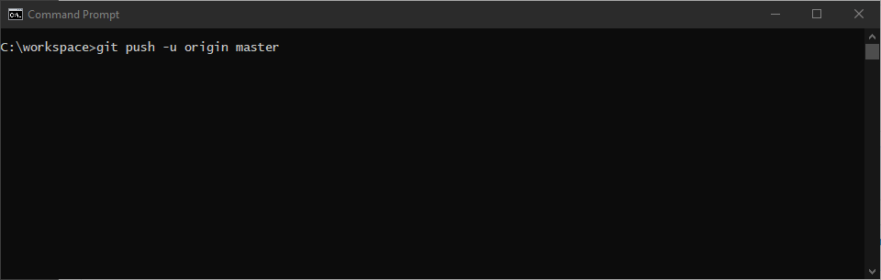
Connecting your local repo to your GitHub repo (continued)
To link your GitHub repo with the local repo you created earlier you need to copy the following two lines of code:
Then paste into your Command Line window

Slide 8
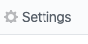
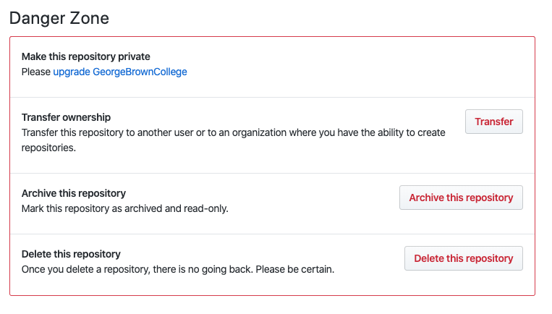
Deleting a repo
Sometimes you need to remove a repo. This may be due to broken connections between your local repo (on your computer) and your GitHub repo (or other problems).
Step 1: Click on the Settings link on your repo’s page
Step 2: scroll down to the Danger Zone and select the Delete this repository button

Slide 9
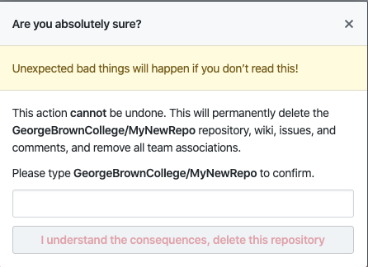
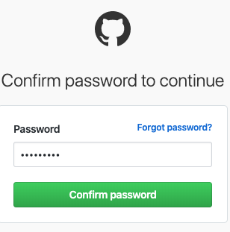
Deleting a repo (continued)
Step 3: Confirm that you wish to Delete the repo. You cannot undo this action.
Step 4: Click the I understand the consequences, delete this repository button. You will then be asked to confirm by entering your account password.

Slide 10
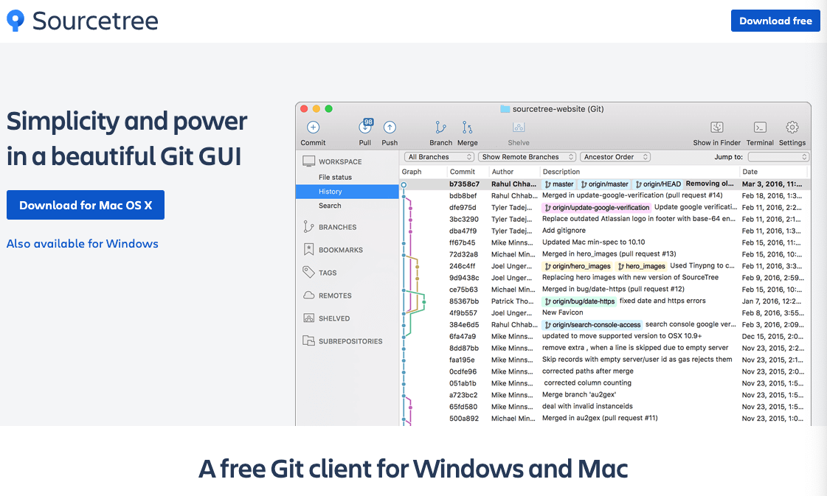
Common GUI Clients
Sourcetree: https://www.sourcetreeapp.com/

Slide 11

Common GUI Clients (continued)
GitKraken: https://www.gitkraken.com/

Slide 12
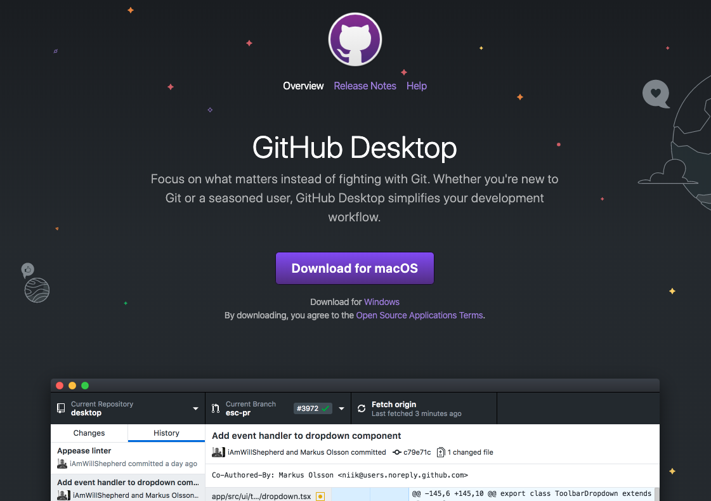
Common GUI Clients (continued)
GitHub Desktop: https://desktop.github.com/

